Slide 1
Notes on Formal Writing
Synthesized by Mrs. Snell

Slide 2
Point of View

Slide 3
Person (Point of View)
First person is acceptable when writing a narrative.
All other essays and research papers are to be written in third person.
Second person “you,” “your,” and “yourself” should never be used in formal writing unless they are part of a direct quotation.

Slide 4
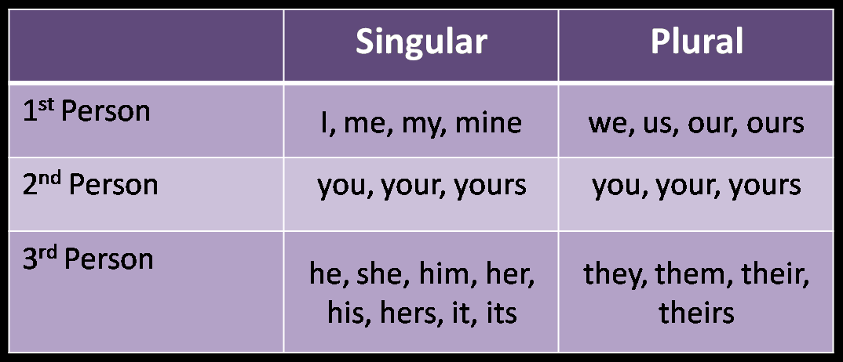
Pronoun Chart

Slide 5
Verbs
Active vs. Passive

Slide 6
Tense
Writing in active voice is preferable to passive voice.
Active Voice:
Truman Capote wrote In Cold Blood.
Passive Voice:
In Cold Blood was written by Truman Capote.

Slide 7
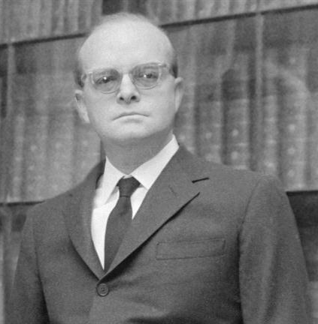
Verb Tense
It is important to be consistent with your verb tense. Don’t switch between past and present tense.
Incorrect: “Capote writes about Perry Smith and Dick Hickock. He wrote the book because…”
Capote wrote in the past.

Slide 8
Sentence Structure

Slide 9
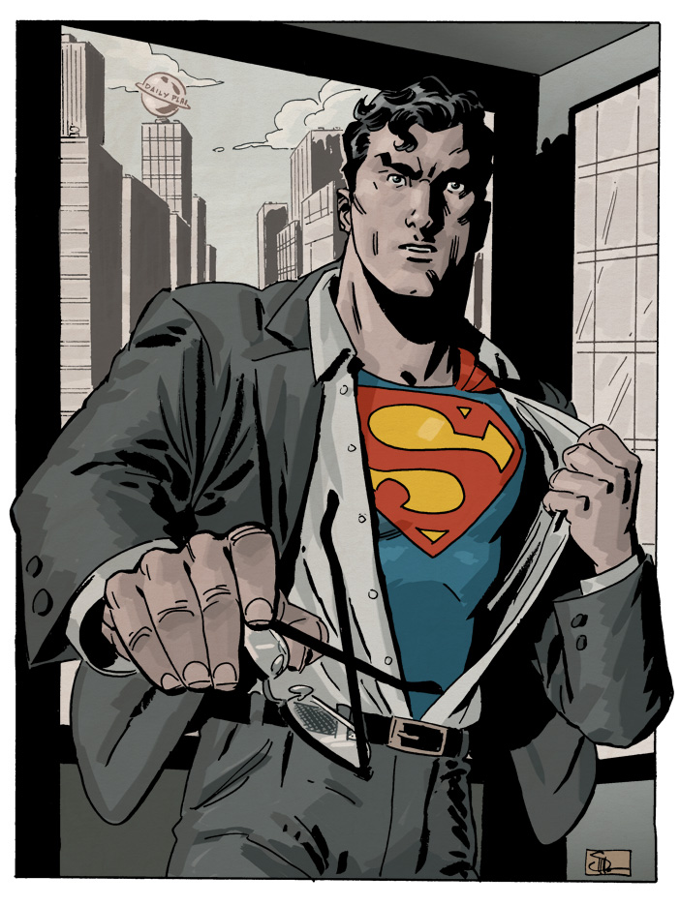
Sentence Structures to Avoid:
Sentence Fragments
Able to leap buildings in a single bound.
Run-on Sentences
Clark had vanished he left his eyeglasses and coat in the telephone booth.

Slide 10
Sentence Structures to Avoid:
Run-on Sentence
Clark had vanished he left his eyeglasses and coat in the telephone booth.
Comma Splice
Clark had vanished, he left his eyeglasses and coat in the telephone booth.
Correct:
Clark had vanished, but he left his eyeglasses and coat in the telephone booth.
Correct:
Clark had vanished; he left his eyeglasses and coat in the telephone booth.

Slide 11
Avoiding Comma Splices
Example of a comma splice:
This next chapter has a lot of difficult information in it, you should start studying right away
Comma slices can often be repaired by use of a semi-colon
This next chapter has a lot of difficult information in it; you should start studying right away

Slide 12
Sentence Structure: Simple
Use simple sentences SPARINGLY.
Some writers overuse simple sentences. These sentences are short. Lots of simple sentence make writing choppy. Ideas often feel random and disconnected. Simple sentences are simple. They make your thinking seem simple.

Slide 13
Sentence Structure: Compound
A compound sentence contains two independent clauses correctly joined together.
Two independent sentences:
I’d like to beat this level of Angry Birds.
I have an English paper due tomorrow.

Slide 14
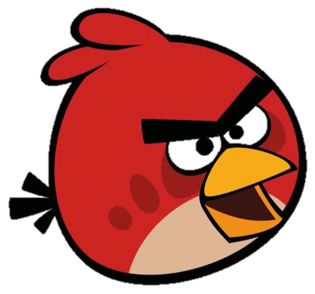
Coordinating Conjunctions
I’d like to beat this level of Angry Birds, but I have an English paper due tomorrow.
Coordinators: for, and, nor, but, or, yet, so.
Acronym: F a n b o y s

Slide 15
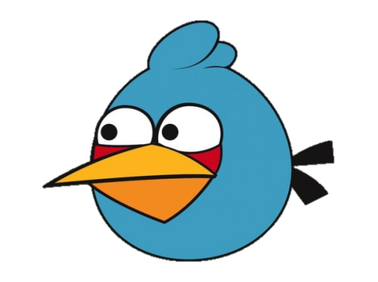
Conjunctive Adverbs
Sometimes compound sentences will use conjunctive adverbs.
I’d like to beat this level of Angry Birds; however, I have an English paper due tomorrow.
Conjunctive Adverbs: however, therefore, nevertheless, conversely, furthermore, etc.

Slide 16
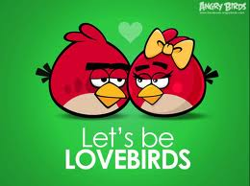
Correlative Conjunctions
Either I’ll spend the entire night playing Angry Birds, or I will be able to turn my paper in on time.
Other Pairs:
both...and
not only...but also,
whether…or

Slide 17
Sentence Structure: Complex
A complex sentence has an independent clause joined by one or more dependent clauses.
I won’t be able to play Angry birds / because
I have an English paper due tomorrow.

Slide 18
Concision Tip:
Avoid starting sentences with phrases such as“it is,” “there is,” and “there are.”
There are a number of reasons I won’t be able to play Angry Birds tonight including the fact that I have an English paper due tomorrow.

Slide 19
Punctuation

Slide 20
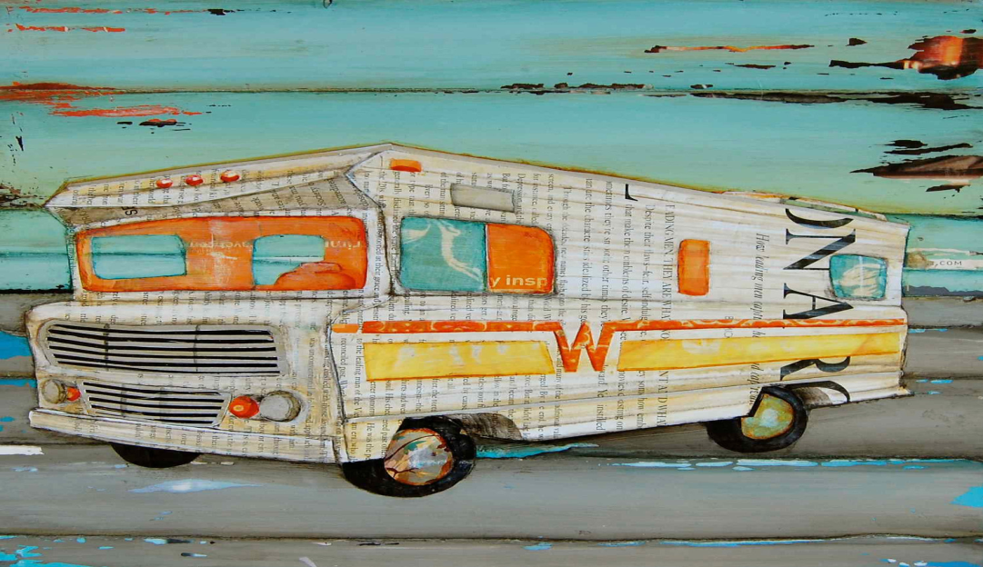
Punctuation: Oxford Commas (,)
Amanda found herself in the Winnebago with her ex-boyfriend, a zoologist and a pet detective.
Amanda found herself in the Winnebago with her ex-boyfriend, a zoologist, and a pet detective.

Slide 21
Punctuation: Exclamation Points (!)
Limit yourself to one exclamation point per trimester .
Instead of exclaiming, let the power of your prose and the quality of your ideas draw attention to a sentence.

Slide 22
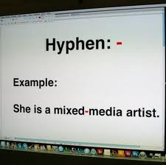
Punctuation: Hyphens (-)
Hyphenate compound words functioning as adjectives preceding words they modify.
Examples:
“a well-known contemporary,”
“a nineteenth-century poet”

Slide 23
Punctuation: Colons (:)
The colon is used for a variety of reasons: to introduce a list, precede a quote, or prepare the reader for something momentous.

Slide 24
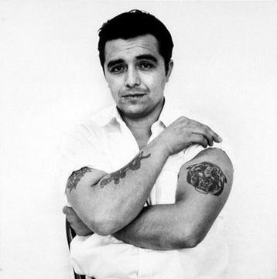
Punctuation: Quotes (“”)
In America and Canada, commas and periods are inside the quotation marks except the case of a internal citation.
Save the single quotation marks for quoting direct speech within a quotation
Capote stated, “separated from him, Perry felt ‘like somebody covered with sores. Somebody only a big nut would have anything to do with’” (260).

Slide 25
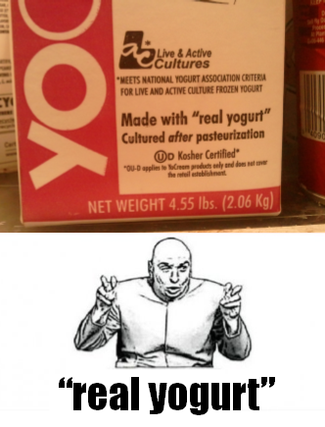
Punctuation: Quotation Marks (“”)
Quotation marks should NOT be used for emphasis.
Air quotes are for sarcasm or extra emphasis.

Slide 26
Punctuation: Quotes
When word processing:
Italicize titles of books, newspapers, magazines, plays, films, long poems, television shows.
When hand writing:
Underline titles of books, newspapers, magazines, plays, films, long poems, television shows.
Always:
Put quotes around titles of essays, short poems, short stories, articles.

Slide 27
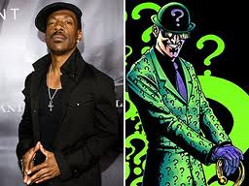
SHOULD I USE QUESTIONS IN MY WRITING?
Safe answer= NO.
Broad answer= NO.
Should I do this on the exam? NO.
Does Mrs. Snell like questions in papers? NO.
But what about as an attention getter? NO…NEVER!
Precise answer= Yes, if used correctly.
For example, in an argumentative essay, you can use rhetorical questions to strengthen your argument.

Slide 28
Diction

Slide 29
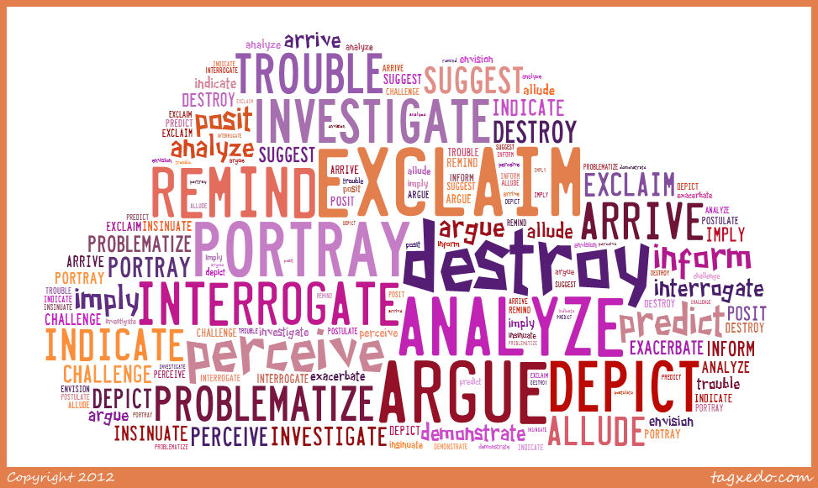
Diction: Active Verbs
Use active verbs whenever possible
Example: “Capote says” vs. “Capote is saying”
NOT ACTIVE VERBS:
“am,” “is,” “are,” “was,” “were,” and “been”

Slide 30
Diction: Tentative Verbs
Tentative verbs, like “seems” and “appears,” show your insecurity about what you are saying. REPLACE them with forceful, positive verbs.
Avoid statements like “Capote tries to show…” He wasn’t a professional writer because he failed to communicate his points.

Slide 31
Diction: Adjectives
Avoid unnecessary intensifiers, such as “so,” “very,” and “obviously”
The quality of your insight will reveal itself in well-chosen words and precise phrases.
Avoid wordiness:
That movie was amazing.
That movie was so amazing.
Obviously, that movie was very extremely amazing.

Slide 32
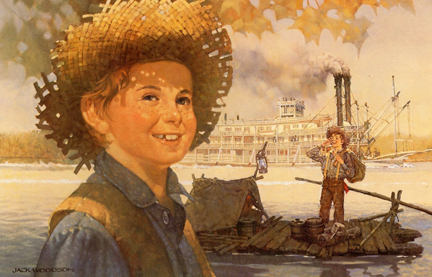
Diction: Colloquialisms
Avoid using slang, regional colloquialisms, and contractions.
Example: spell out “do not” instead of using “don’t”
Your formal essays should not sound like
Huckleberry Finn.

Slide 33
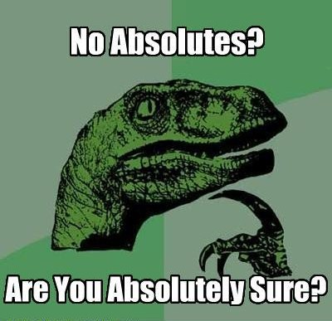
Diction: Absolutes
NEVER say NEVER
Also, avoid other absolutes including “always,” “everybody,” “nobody,” etc.
These can be misconstrued as hasty generalizations

Slide 34
Diction: Homonyms
IT’S | ITS
Always means “it is” | Is a possessive pronoun or indefinite gender

Slide 35
Diction: Homonyms
Their | There | They’re
Possessive pronoun | Demonstrative pronoun | Contraction for “they are” *Remember to not use contractions in formal writing and you won’t misuse this one.

Slide 36
Diction: Confusion
Affect | Effect
-As a Verb Means “to cause a change in, to produce an effect, and to display falseness or pretense” | -As a Verb Means “to cause or bring about”
-As a Noun Means “a feeling, an emotion” | -As a Noun Means “a consequence, result, change”

Slide 37
Diction: Confusion
LAY | LIE
“to place or put” Example: Please lay your books down. | “to recline or rest” Example: I’m going to lie down in my bed.
Laying: present tense Laid: past tense | Lying: present tense Lay: past tense

Slide 38
Diction: Confusion
FEWER | LESS
Fewer applies to units -Modifies a plural noun* Example: fewer people, things, ideas | Less applies to quantity -Modifies a singular noun* Example: less joy, anger, money

Slide 39
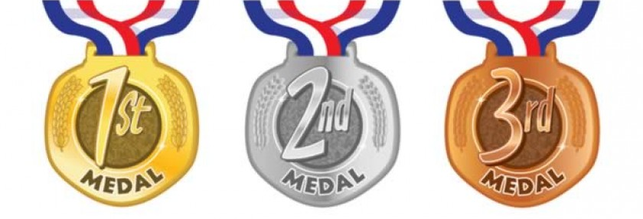
Diction: miscellaneous
When enumerating points…
First is preferable to firstly,
Second is preferable to secondly, etc.

Slide 40
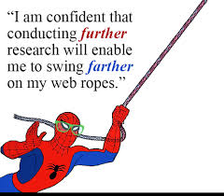
Farther vs. Further
Use farther for spatial distance
Ex. The hike was farther than I thought
Use further for more abstract meaning
Ex. Further research will be required.
Ex. That couldn’t be further from the truth

Slide 41
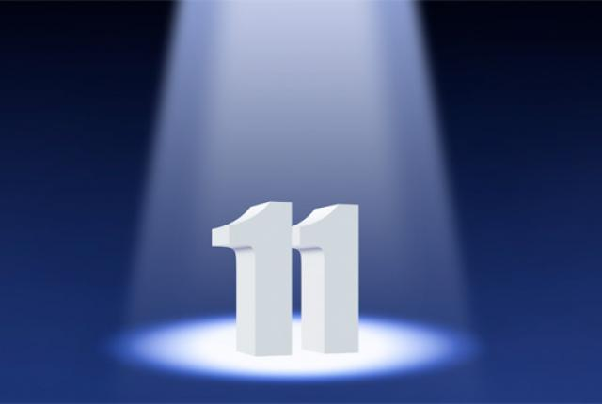
Diction: Numbers
Spell out numbers zero-ten.
One, Three, Seven, Ten
11 and above can be digits
11, 1,003, 10,000,001
What makes 11 so special?

Slide 42
Summative Remarks
http://www.youtube.com/watch?v=8Gv0H-vPoDc&safety_mode=true&persist_safety_mode=1

Slide 43
To be a stellar formal writer…
Say what you have to say once and well.
Get to the point and do not be repetitive just to fill word requirements.
Work toward writing that is direct and clear, organized and coherent, forceful and convincing.
ALWAYS read your paper aloud as you proofread; your ear may catch mistakes that your eye misses.

